Slide 1
CSC216 Comparison: Fall 2015 and 2016
By Adam Abram

Slide 2
Primary Question & Hypothesis
How are classrooms impacted by…
Renaming assignments
Integrating labs into a larger project
Increasing the number of labs and guided projects
Implementing Process Points
We hypothesize that these interventions will result in an increase of:
Retention: How many students pass the class, and remain in CS
Efficacy: The belief that students are capable of learning CS
Learning: How well the students picked up the material
Engagement: Use of office hours and message boards

Slide 3
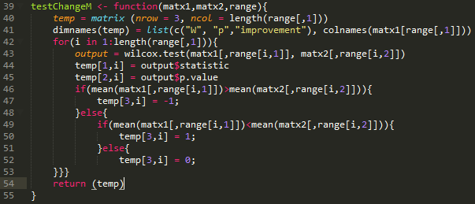
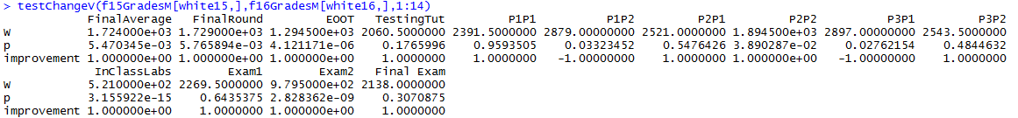
Methodology
Scripts
Aim for versatility
Aim for consistency
Aim for legibility
The primary test used was the Mann-Whitney test

Slide 4
Results & Conclusions
Students performed better on the fall 2016 Object Oriented Tutorial/Guided Project
As a whole, the interventions appear to be helpful
 | Object Oriented | Testing | P1P1 | P1P2 | P2P1 | P2P2 | P3P1 | P3P2 | Exam1 | Exam2 | Final Exam | Final Average
All | + |  |  | - |  |  | - |  |  | + |  | +
White | + |  |  | - |  | + | - |  |  | + |  | +
Asian | + | + |  |  |  |  |  |  |  | +
Other | + |  |  |  |  |  |  |  |  | + |  | +
Women | + | + |  |  |  |  |  |  |  | + |  | +
Men | + |  |  | - |  |  |  |  |  | + |  | +
Experienced Students | + |  |  |  | + |  |  |  |  | + |  | +
Unexperienced Students | + |  |  | -
First Attempt | + |  |  | - |  |  |  |  |  | + |  | +
2nd+ Attempt | +
Sophomore | + |  |  |  |  |  |  |  |  | + |  | +
Junior |  |  |  | -

Slide 5
Threats to Validity
Inconsistent grading for labs (completion vs details)
Differences in grading by TAs in each semester
Different Instructors

Slide 6
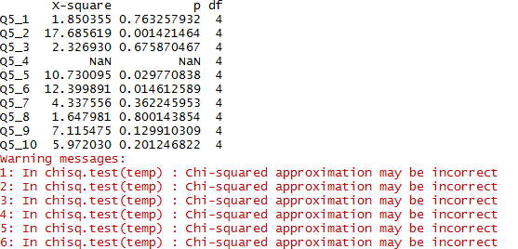
Next Steps & Other Work
Examine Survey Responses
Examine grades by soft drop
Examine office hours

Slide 7
integrated labs in 16
more labs in 16
labs were seperate from lectures
Add animations in general
Side by slide slide 2, remove defs, add data sources
Make slide three flow chat etc., add process (eg data wrangling)
Rename "new students" (no outside exp.?) & in class labs, make table bigger move final average
explanation for + exam 2 (labs)
elaborate on how to examine differences due to soft drops & different prof.

